Slide 1
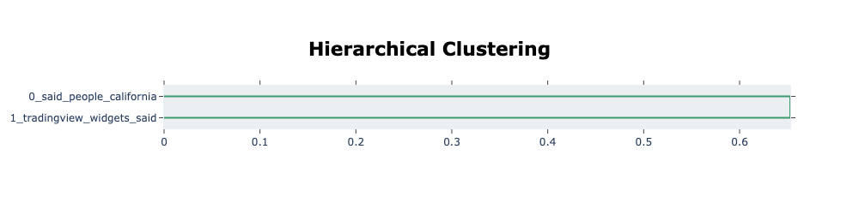
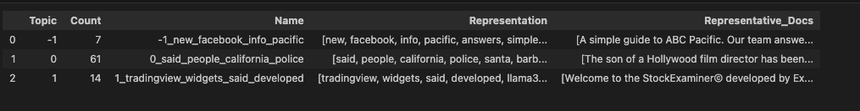
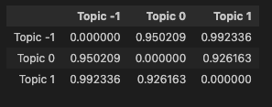
F_20140524_CA
Notes:
B: 1149
A: 76
FB: 0
HE:2
Twitter:5

Slide 2
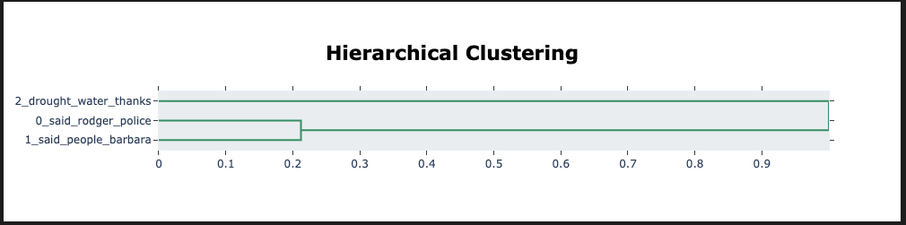
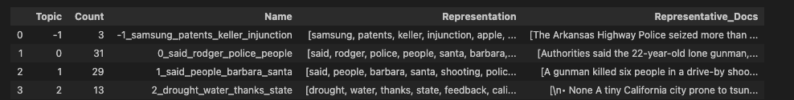
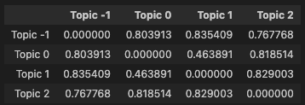

d_20140524_CA

Slide 3
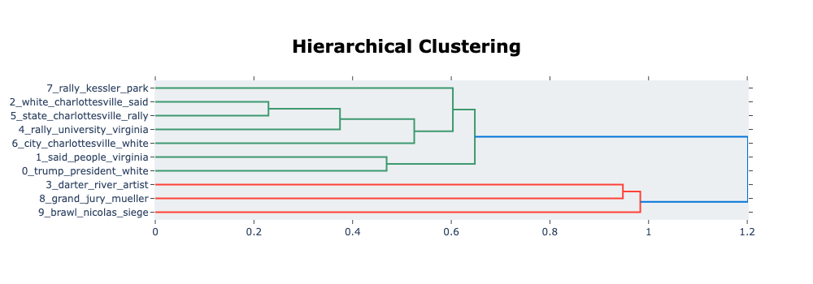
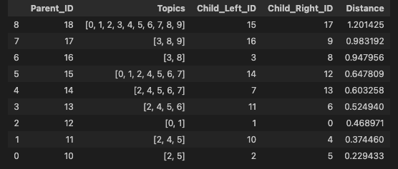
F_20170812_VA
Notes:
B:1104
A:234
HE: 1
Twitter:0
Fb:41

Slide 4
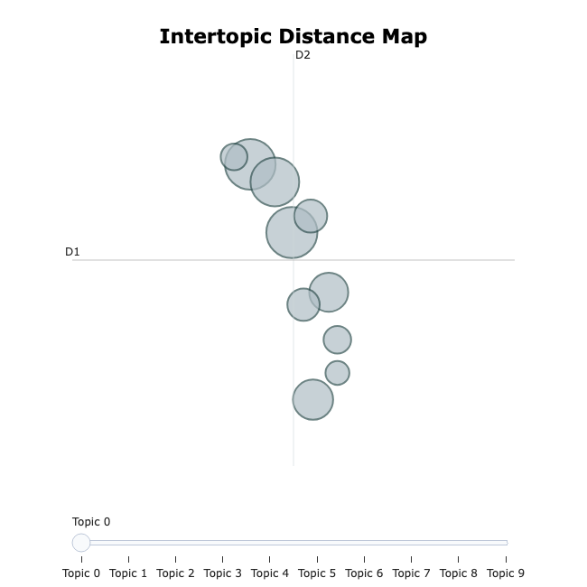
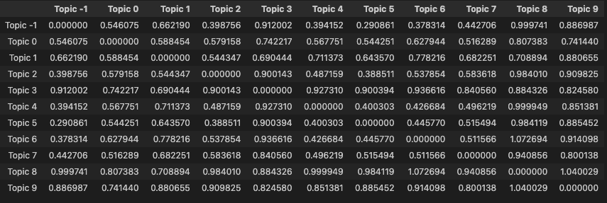
F_20170812_VA

Slide 5
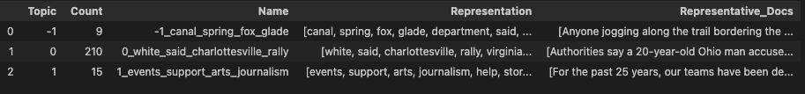
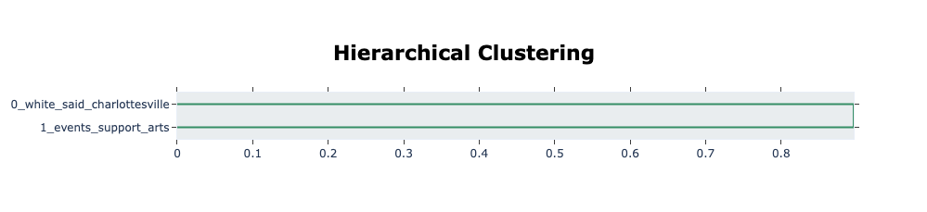
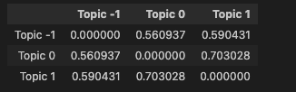
d_20170812_VA

Slide 6
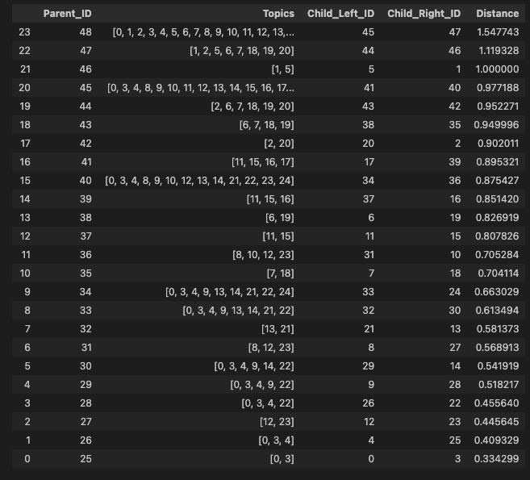
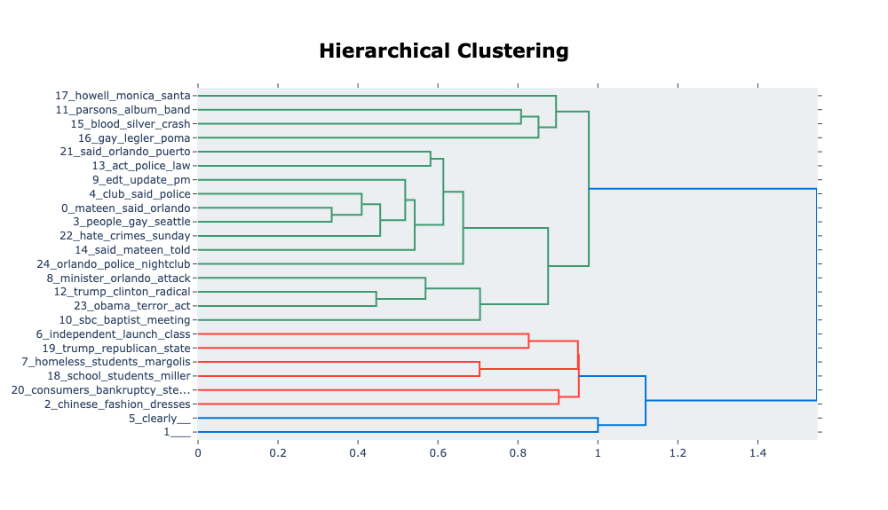
F_20160612_FL
Notes:
Each row in the DataFrame represents a merge between two previously separate topics (Child_Left_ID, Child_Right_ID) into a new Parent_ID.
The Distance value quantifies how far apart the two child clusters were in the topic embedding space before merging.
It comes from the linkage function used in hierarchical clustering (default is "ward"), which operates on the pairwise intertopic distances derived from UMAP/c-TF-IDF.
2443
694
Twitter:12
Fb:52
HE:10

Slide 7
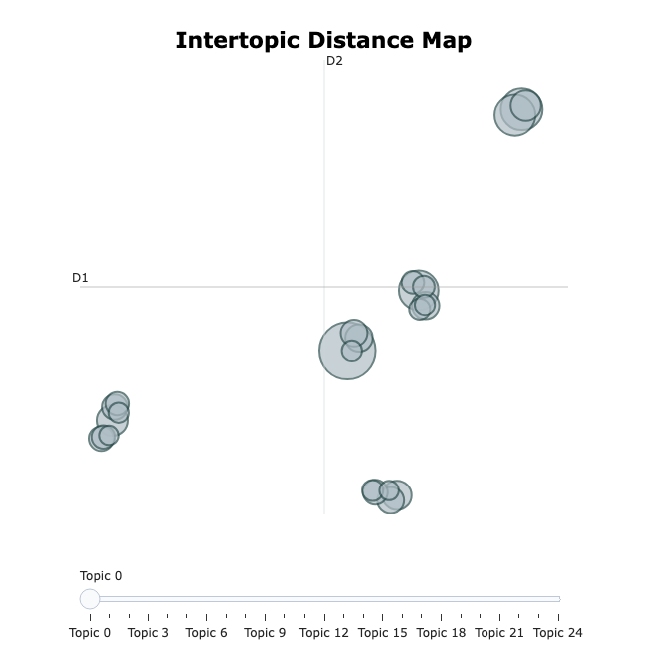
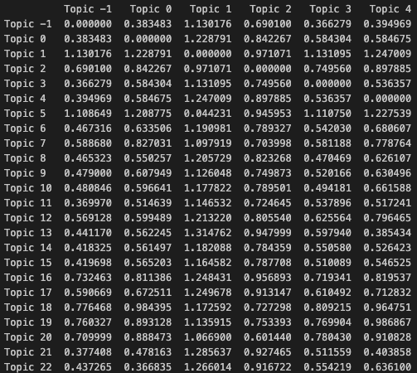
F_20160612_FL
Notes:
euclidean distance

Slide 8
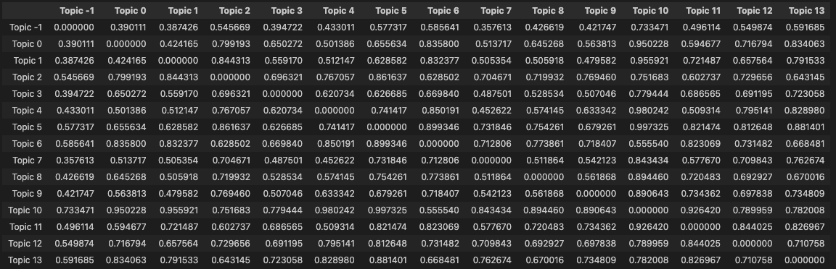
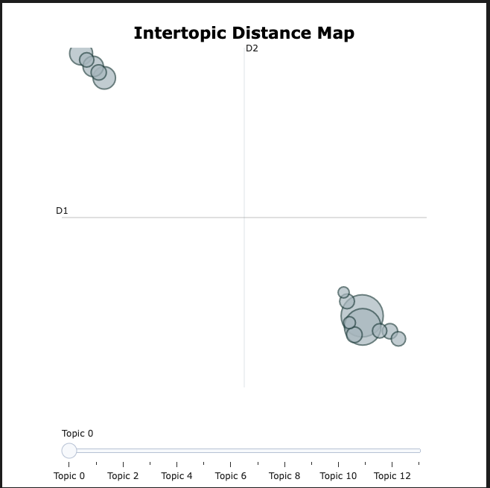
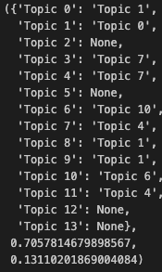
d_20160612_FL

Slide 9
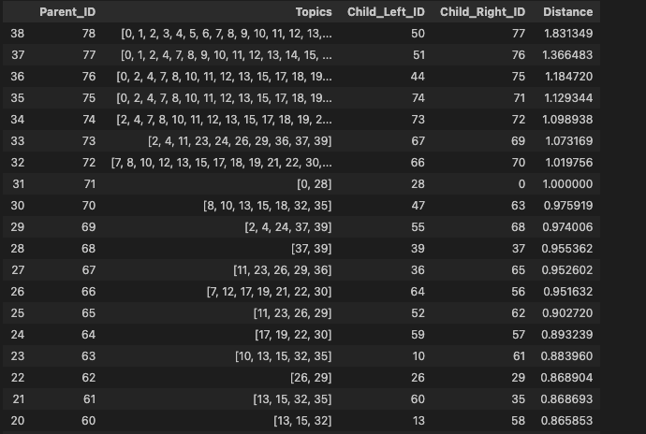
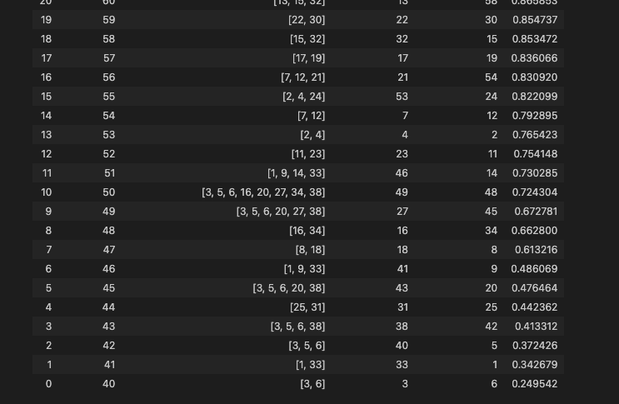
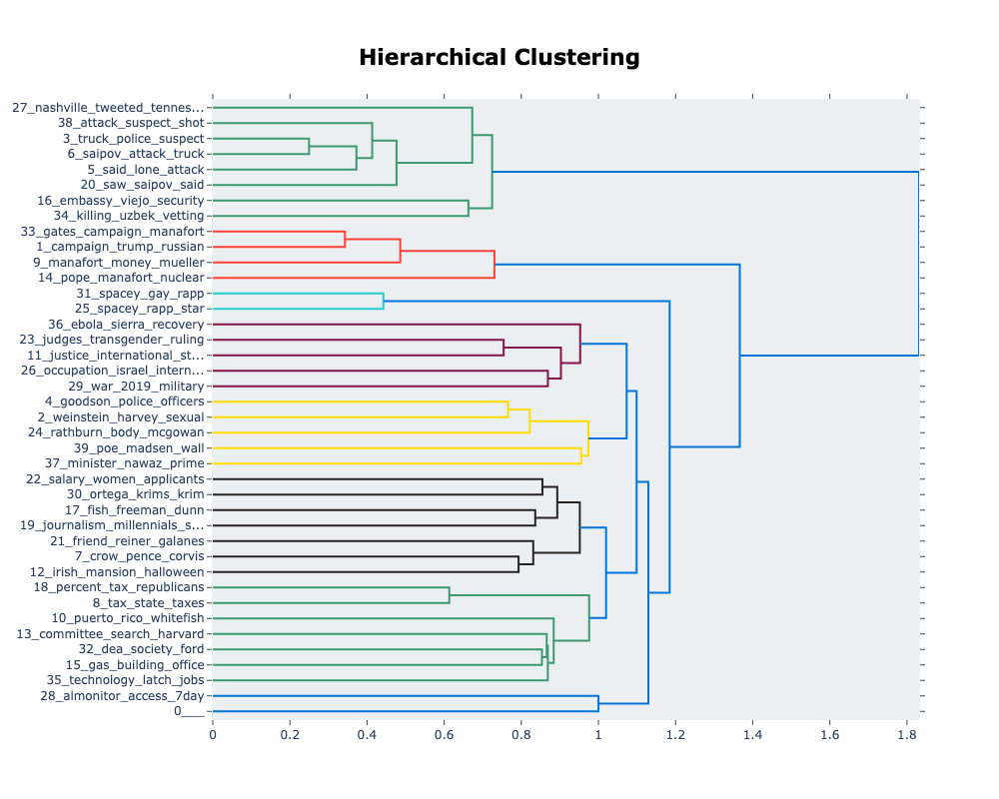
F_20171031_NY
Notes:
B:3404
A:741
HE: 21
Fb:41
Twitter: 7

Slide 10
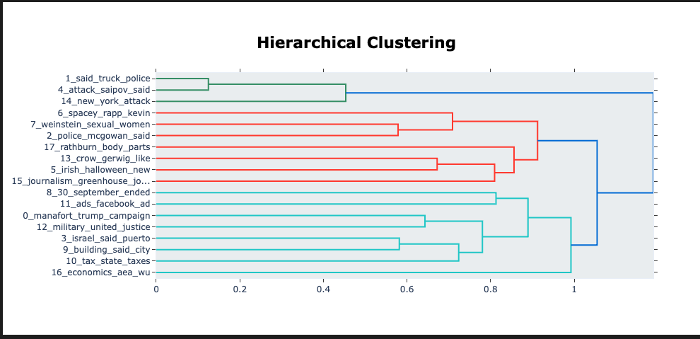
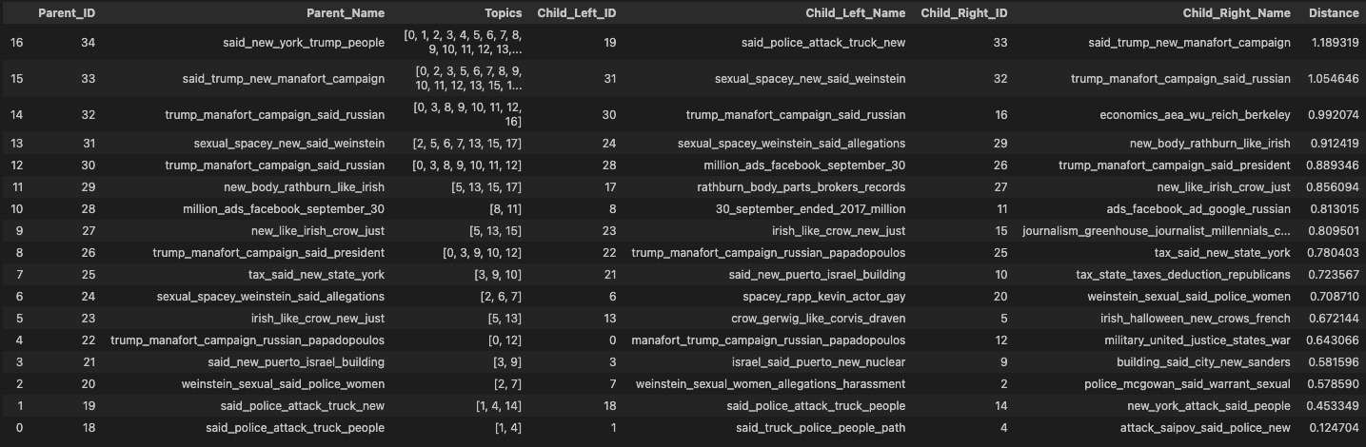
d_20171031_NY

Slide 11
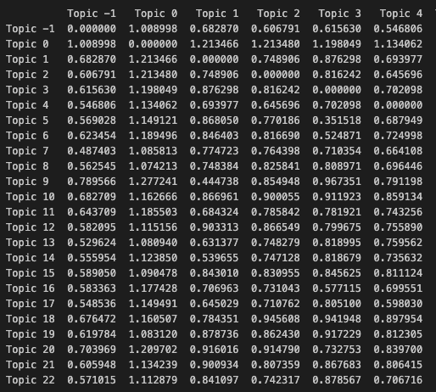
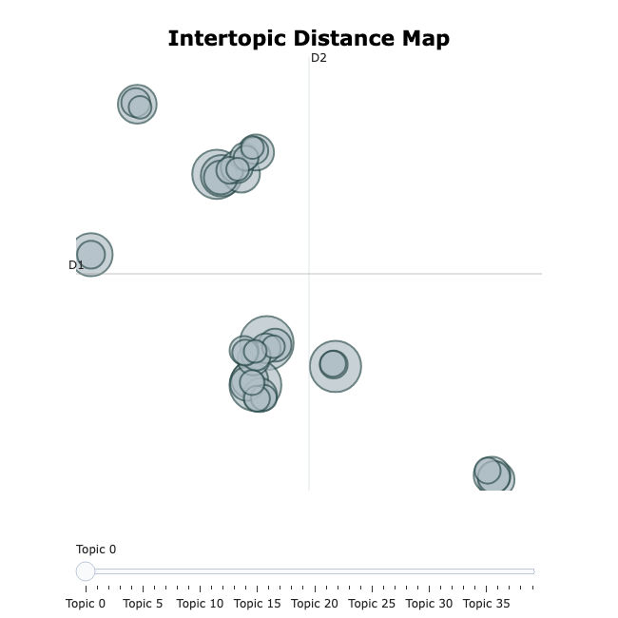
F_20171031_NY

Slide 12
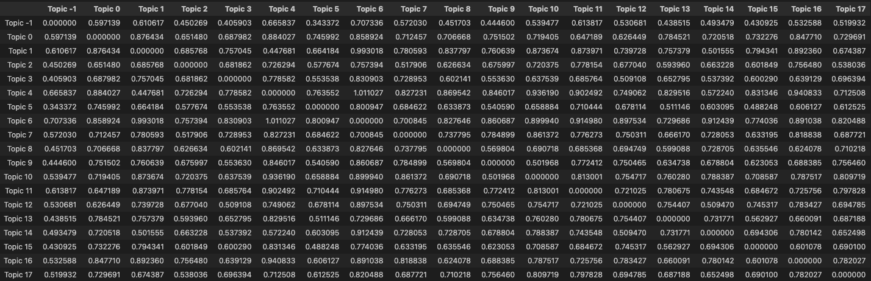
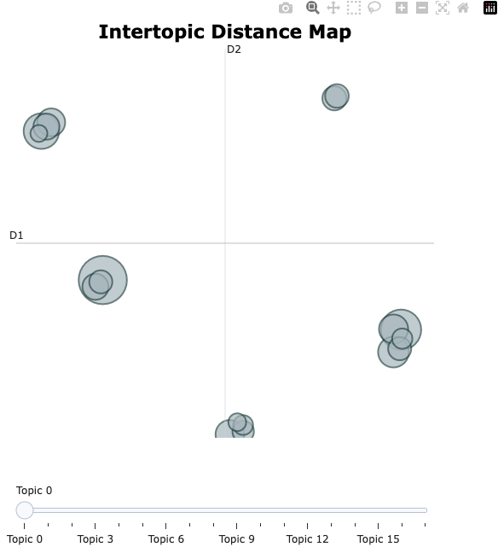
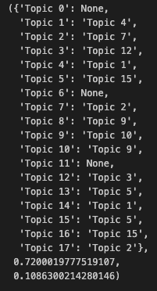
d_20171031_NY

Slide 13
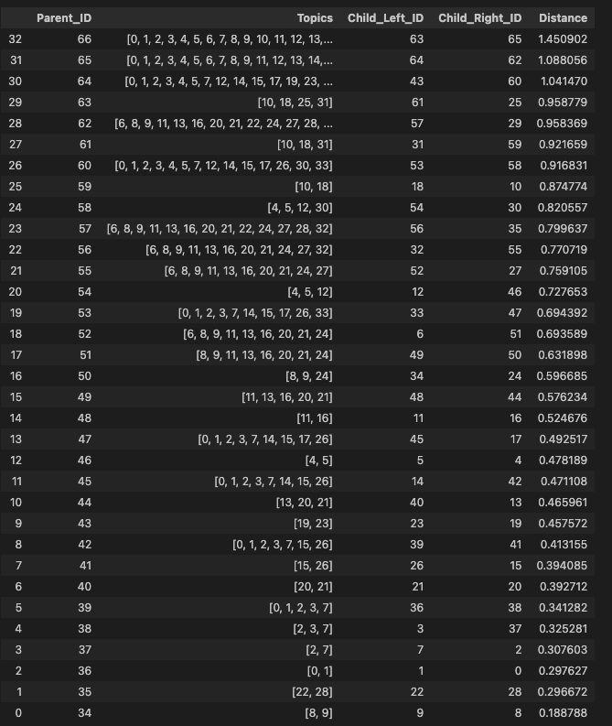
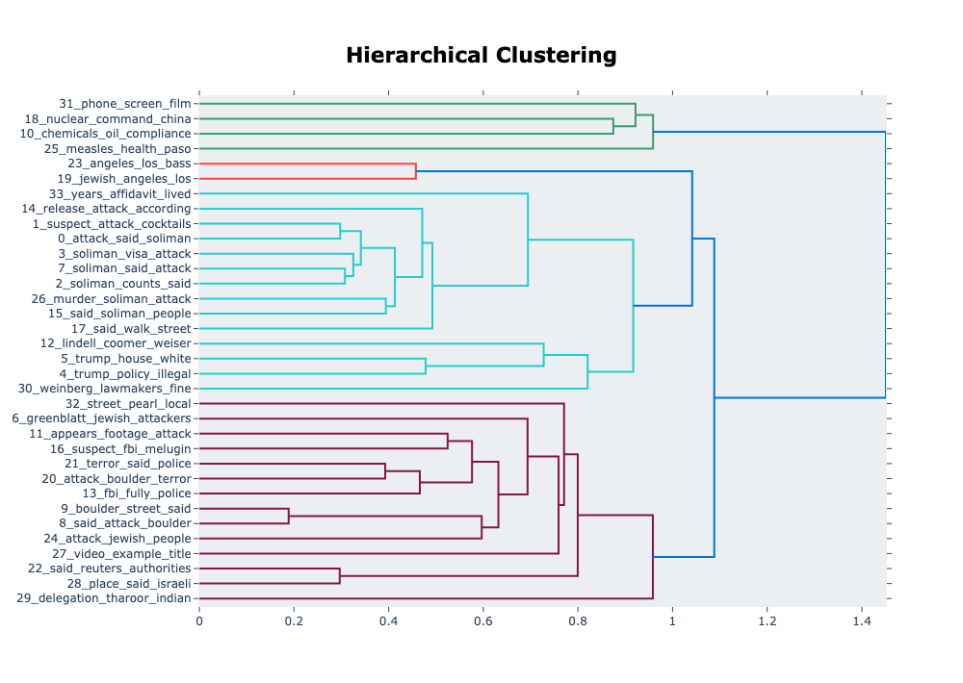
F_20250602_CO
Notes:
B:1215
A:338
FB_H:20
Twitter_H:35
HE: 9

Slide 14
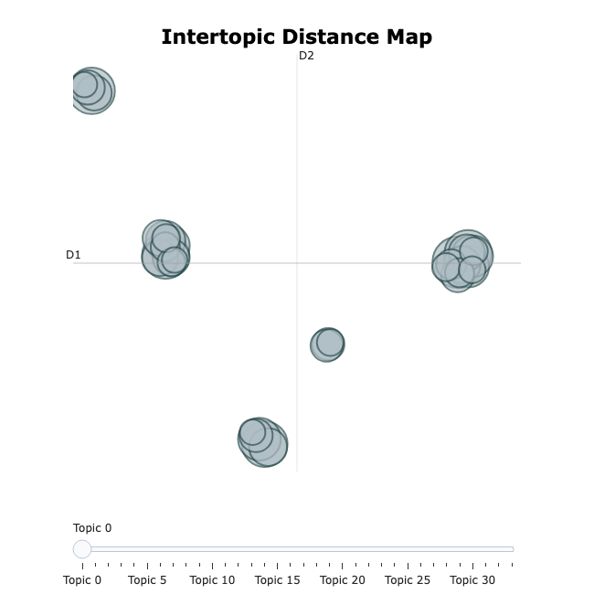
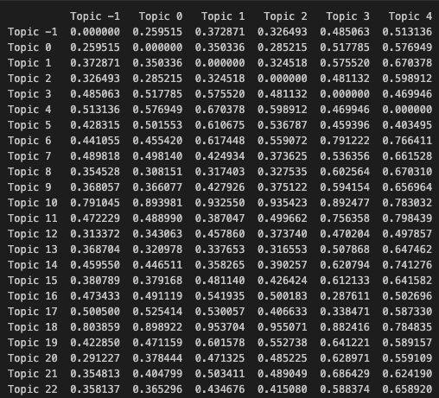
F_20250602_CO

Slide 15
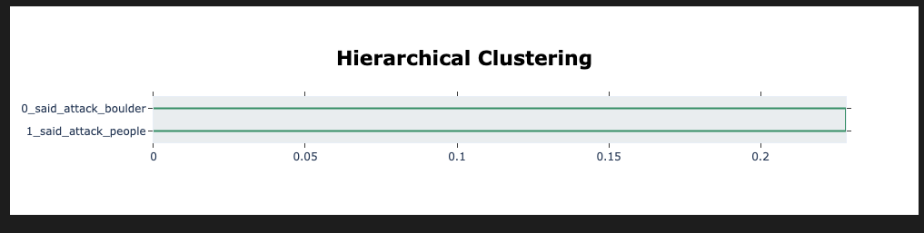
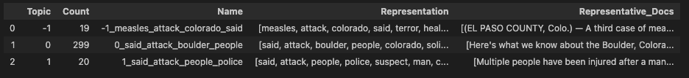
D_20250602_CO

Slide 16
d_20250602_CO

